Slide 1

Rechnerarchitekturen für Deep-Learning Anwendungen (RADL)
Dustin Heither, Maximilian Achenbach, and Robert Kagan
Optimizing Deep Learning Performance:
A Hybrid CPU-GPU Framework with Multithreading, SIMD,
and Evaluation of Efficiency Metrics

Slide 2
Outline
3. Presentation
01
Tweaks & Enhancements
02
Hardware & Benchmark
03
CUDA tuning
04
OpenMP
05
SIMD
06
Outlook

Slide 3
Tweaks & Enhancements
1 / 2
Addressed extern "C" compatibility issues:
Resolved issues with extern "C" declarations in .c files
Solution: Migrated the entire codebase to C++
Benefit: Facilitated seamless integration with CUDA
Adopted flat array representation:
Improved cache utilization for better performance
Benefit: Simplified integration with CUDA workflows
Optimized malloc usage in functions:
Updated functions:
matrix *add(matrix *a, matrix *b); → matrix *add(matrix *a, matrix *b, matrix *c);
Change: If c is not NULL, the function bypasses malloc
Benefit: Allocations moved outside the main loop for enhanced performance

Slide 4
Tweaks & Enhancements
2 / 2
Transitioned from the GCC compiler to Clang:
Problem: GCC did not function as expected on macOS
Solution: Clang offers excellent cross-platform support and is particularly optimized for macOS
More differences:
Feature | GCC | Clang
Performance | Generally considered highly optimized, with mature optimizations | Competitive performance, sometimes faster than GCC in certain benchmarks
Optimization | Extensive optimizations (O1, O2, O3, aggressive optimizations) | Similar set of optimizations, sometimes better diagnostics and debugging support
Use Cases | Widely used in embedded systems, scientific computing, Linux distributions | Preferred in environments like macOS, iOS, Android (via Google’s Android NDK)

Slide 5
Hardware & Benchmark
Hardware Overview
CPU | Release dates | TDP (W) | Number of (performance) cores | Number of threads
AMD Ryzen 7 3800XT | 7. Juli 2020 | 105 | 8 | 16
Apple M3 Pro 11-Core | 30. Oktober 2023 | 27 | 5 | 11
Intel Core i7 1065G7 | 1. Juni 2019 | 15 | 4 | 8
GPU | Release dates | TDP (W) | CUDA cores | Base Clock (MHz)
NVIDIA GeForce RTX 2080 | 20. September 2018 | 215 | 2944 | 151
NVIDIA GeForce MX350 | 10. February 2020 | 20 | 640 | 1354

Slide 6
Hardware & Benchmark
Benchmark Overview
Batch size: 1
Epochs: 128
ICPX:
In microseconds (µs)
Averaged over 10 runs
Intel oneAPI C++ Compiler
Old:
In microseconds (µs)
Averaged over 10 runs
Total time (last presentation)
XL:
In microseconds (µs)
Averaged over 10 runs
Image dimensions of (32x30)²

Slide 7
CUDA tuning
1 / 2
Integrated with our framework
Implemented the functions:
matrix *add(matrix *a, matrix *b);
matrix **biasing(matrix **a, int len, matrix *b);
matrix **conv2d(matrix *a, matrix **b, int len);
matrix **flip_kernels(matrix **a, int len);
matrix **hyperbolic_tangent(matrix **a, int len);
matrix *matmul(matrix *a, matrix *b);
matrix **maxpool(matrix **a, int len);
matrix **relu(matrix **a, int len);
matrix *transpose(matrix *a);

Slide 8
CUDA tuning
2 / 2
Current challenges:
matrix *flatten(matrix **a, int len) is not feasible
Current framework prevents effective implementation
Performance bottlenecks:
Each function requires cudaMalloc and cudaMemcpy
Significant overhead reduces overall performance
Proposed improvements:
Centralized memory allocation
Exclusive use of device memory:
Avoid reliance on host memory for computations
Eliminate memory transfer overhead:
Optimize by only working with device memory

Slide 9
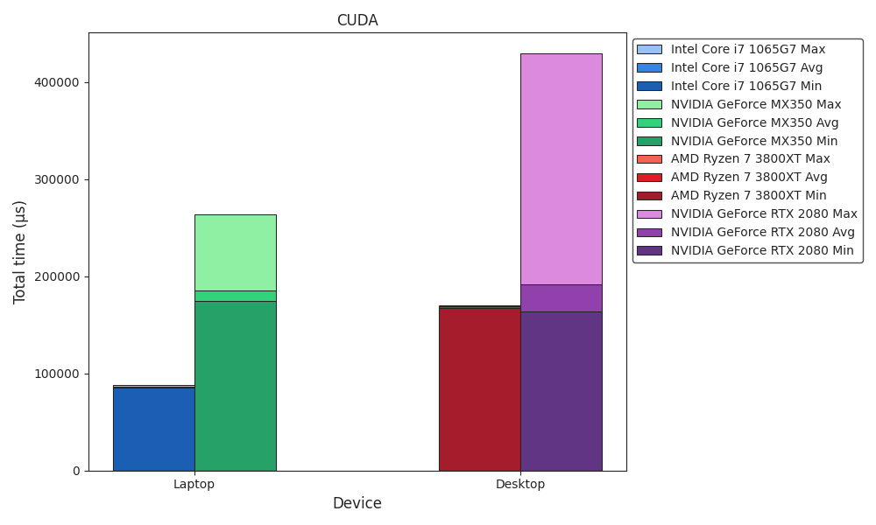
Benchmark
CUDA

Slide 10
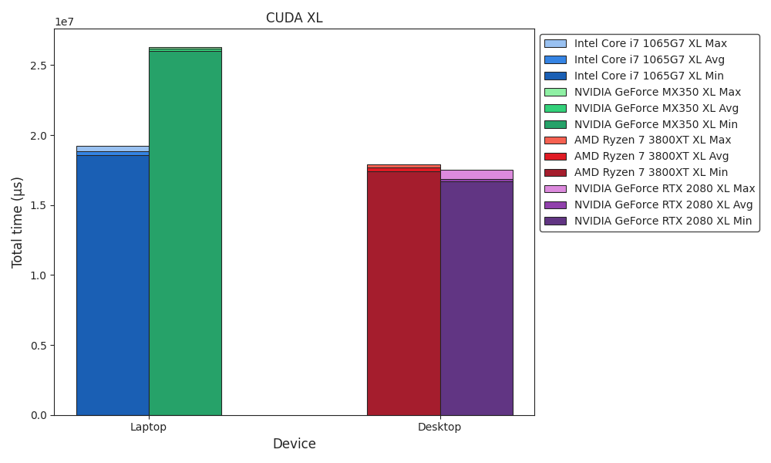
Benchmark
CUDA XL

Slide 11
OpenMP
Implementation
OpenMP overview:
Parallel programming support for C++ with minimal code changes
Efficient execution on multi-core processors
Compiler directives, library routines, and environment variables
Compiler flags:
OMP: -Xcompiler -fopenmp -DOMP
OMP_DARWIN: -Xclang -fopenmp -DOMP
OMP_INTEL: -Xcompiler -qopenmp -DOMP
Implementation:
Integrated OpenMP pragmas for parallel processing
Comparison:
Multi-threaded implementation vs. native compiler multi-threading
matrix *matmul(matrix *a, matrix *b, matrix *c) {
// ...
#ifdef OMP
#pragma omp parallel for collapse(2)
for(int i = 0; i < c->x; i++) {
for(int j = 0; j < c->y; j++) {
c->m[get_idx(i, j, c->y)] = 0.0;
#pragma omp simd
for(int k = 0; k < a->y; k++) {
c->m[get_idx(i, j, c->y)] += a->m[get_idx(i, k, a->y)] * b->m[get_idx(k, j, b->y)];
}
}
}
// ...
#endif
return c;
}

Slide 12
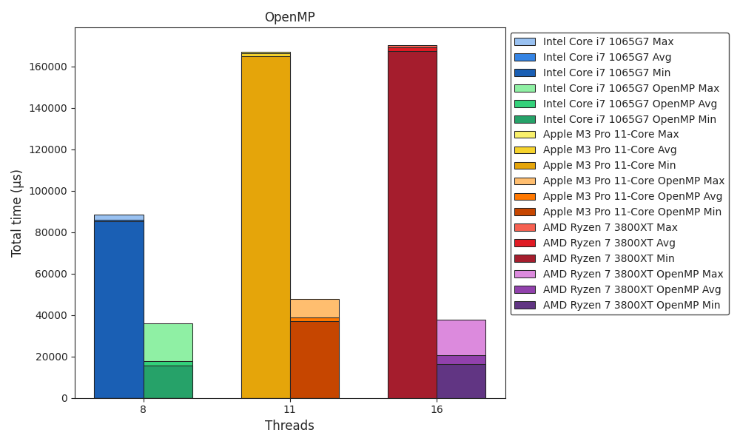
Benchmark
OpenMP

Slide 13
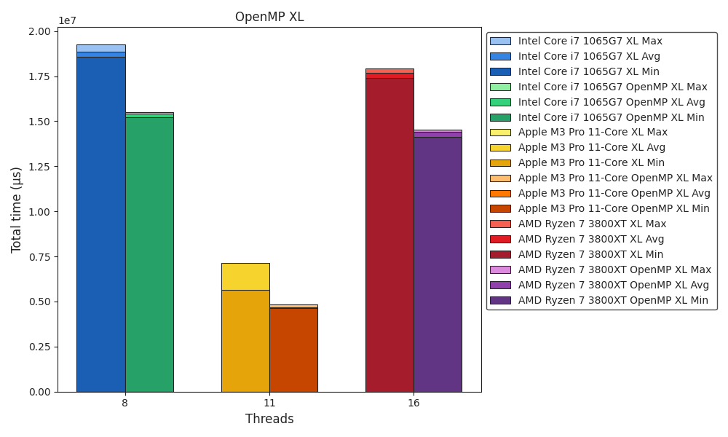
Benchmark
OpenMP XL

Slide 14
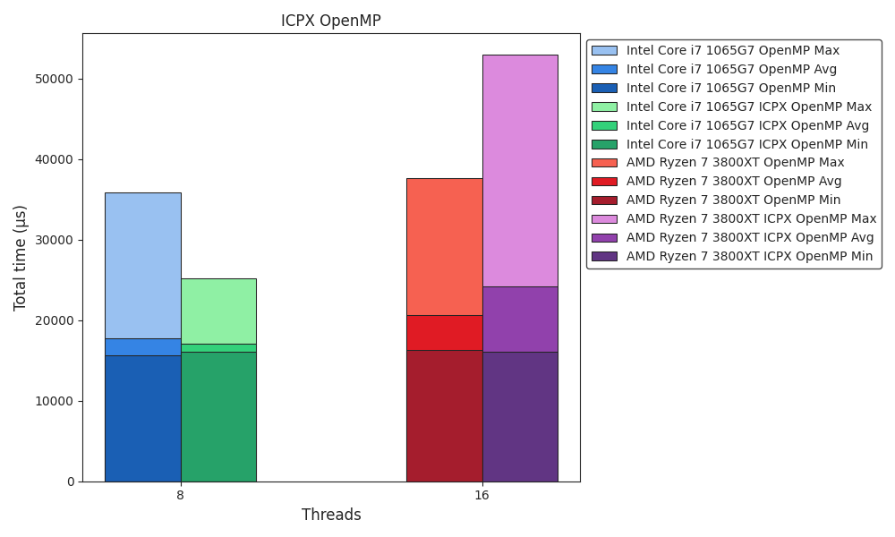
Benchmark
ICPX OpenMP

Slide 15
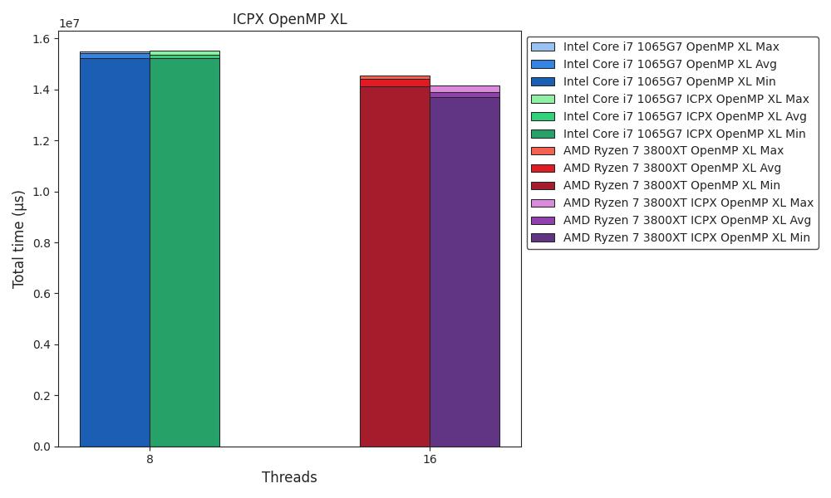
Benchmark
ICPX OpenMP XL

Slide 16
SIMD
Implementation
SIMD (Single Instruction Multiple Data) overview:
Performs operations on multiple data elements in parallel
Accelerates machine learning by processing large datasets faster
Vector Size: 128 bits, handling 4 floating-point values concurrently
Hardware Support: Intel SSE3 (-Xcompiler -msse3), Arm Neon
Implemented Functions:
void add_simd(mt_arg *mt);
void biasing_simd(mt_arg *mt);
void conv2d_simd(mt_arg *mt);
void matmul_simd(mt_arg *mt);
// ...
#if defined(__x86_64__) || defined(_M_X64) || defined(__i386) || defined(_M_IX86)
#define x86
#include <immintrin.h>
// ...
#elif defined(__aarch64__) || defined(_M_ARM64) || defined(__arm__) || defined(_M_ARM)
#define ARM
#include <arm_neon.h>
#endif
// ...
#define VECTOR_SIZE (128)
#define CHUNK_SIZE (VECTOR_SIZE / 8 / sizeof(float))
// ...
void add_simd(mt_arg *mt);
void biasing_simd(mt_arg *mt);
void conv2d_simd(mt_arg *mt);
void matmul_simd(mt_arg *mt);
// ...

Slide 17
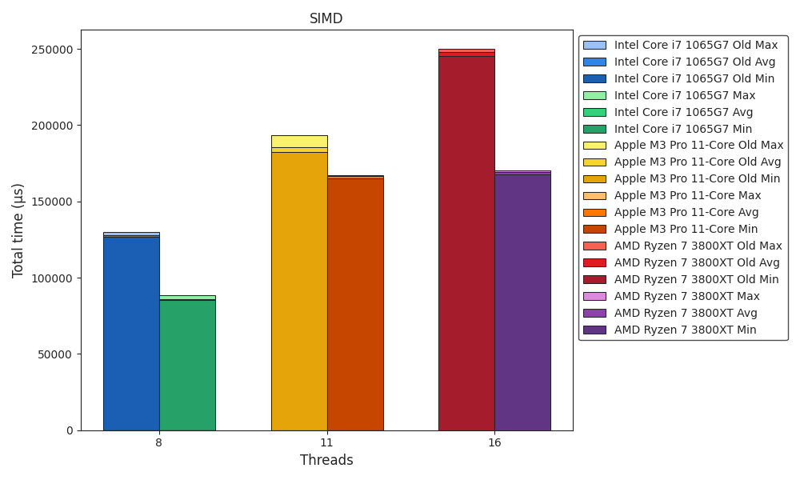
Benchmark
SIMD

Slide 18
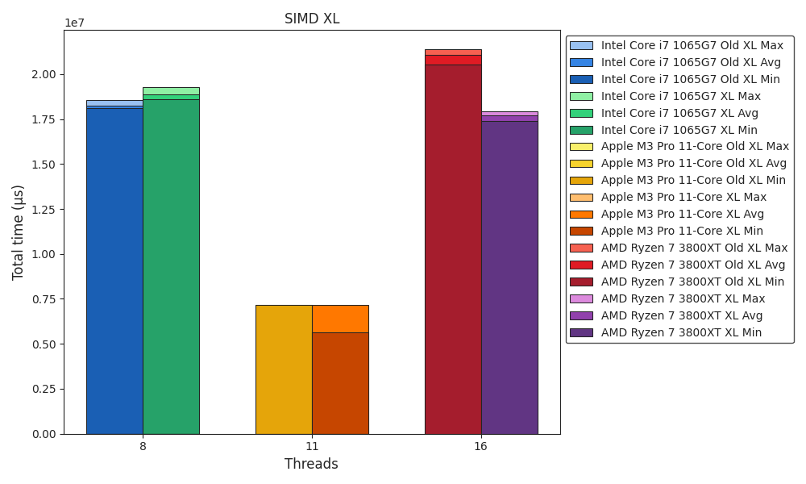
Benchmark
SIMD XL

Slide 19
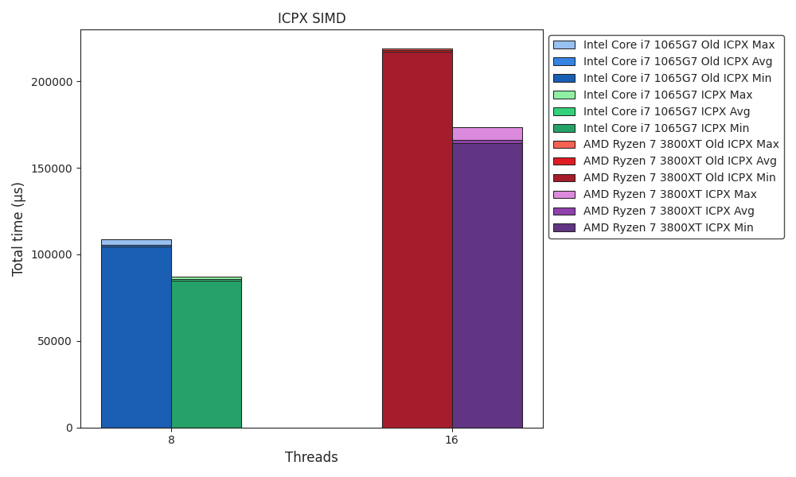
Benchmark
ICPX SIMD

Slide 20
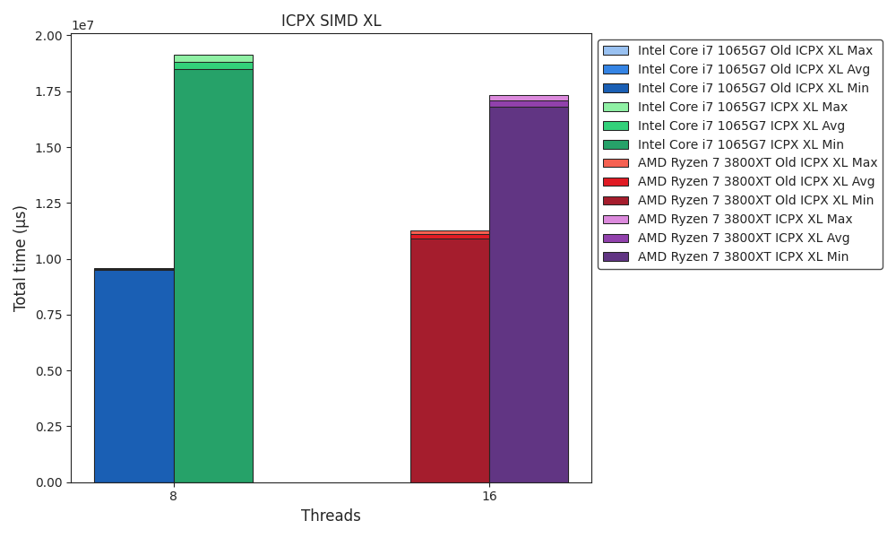
Benchmark
ICPX SIMD XL

Slide 21
Outlook
Work in progress
Framework ✔
ICPX vs. Clang ✔
CUDA tuning ✔
Eliminate memory transfer overhead
Multithreading ✔️
OpenMP GPU offload target
SIMD ✔
Arm SVE
AVX-512
Quantization
(Apple M3 Pro NPU)

